Slide 1
Spatial Awareness Program
Devansh Shah , Rishabh Leelchand, Harry Jia, James Hanna

Slide 2
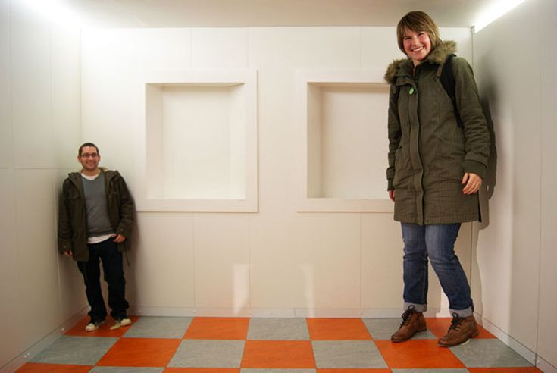
Introduction to the Problem
Spatial awareness refers to one’s ability to aware of objects in their surroundings and their body relative to the objects. It is essential for orientation and movement throughout surroundings.
While all senses are required to develop spatial awareness, vision contributes the largest by allowing individuals to visually perceive their surroundings
A common issue for individuals with vision impairments is their spatial awareness can be hindered from reduced distance/depth perception from the onset of myopia & presbyopia, to no vision perception due to full blindness.
Current aides for this problem include the use of walking sticks, touching objects, listening for surroundings and muscle memory in familiar environments such as walkways in ones’ household.

Slide 3
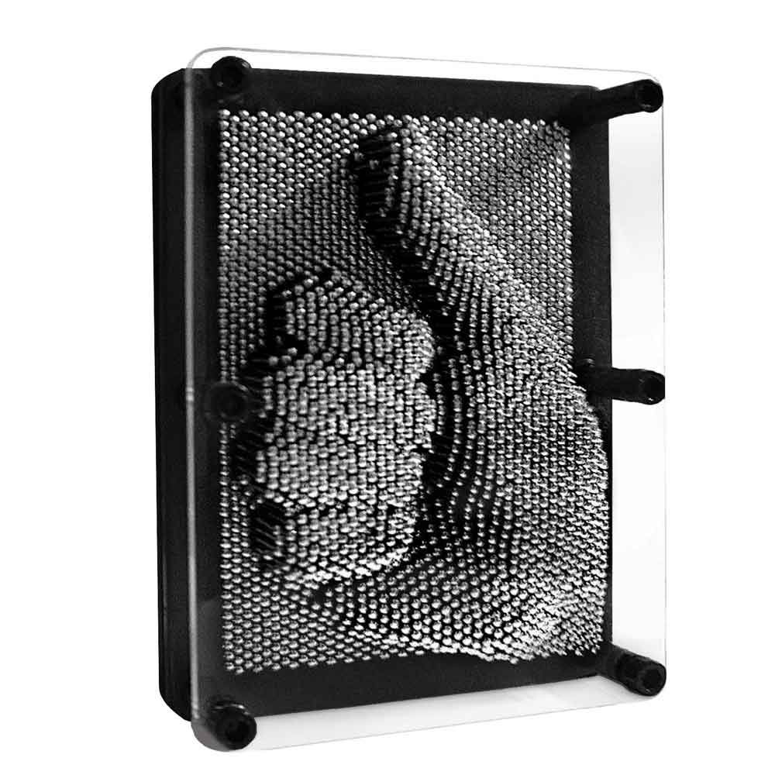
Introduction to the Solution
The Spatial Awareness Program aims to provide a quick and efficient solution that trades vision for touch to develop an individuals’ spatial awareness.
The program utilizes a LiDAR laser to scan a room to obtain distance data, for a matrix of data points in front of the individual. The program will then reproduce the scan onto a 3D display that can be felt by the user to allow them to interpret the surrounding surrounding environment, like pin art.
The model we have developed performs this action by utilizing the servos to position the LiDAR at data points and take measurements which are then stored in a matrix. The matrix is then serialized and developed into a visual display in Python. During the scan, the accelerometer monitors the orientation to guarantee a steady scan is conducted while being held by the user.

Slide 4
Main Modules of the Solution

Slide 5
LiDAR & Servometer Operation

Slide 6
Orientation Regulation of System

Slide 7
Serialisation of Output

Slide 8
Display of Output in Python

Slide 9
Overview of Testing Procedures

Slide 10
Demonstration of Model

